Slide 1

PARSHVANATH CHARITABLE TRUST’S
A.P. Shah Institute of Technology
Thane, 400615
Academic Year: 2022-23
Department of Computer Engineering
CLOUD COMPUTING MINI PROJECT
PROJECT TITLE: LAB MASTER
BY
113 - SUHAS MURTHY ()
44 - MRUNAL MISALE ()
94 - AMEY MAHAJAN (20102090)

Slide 2
Abstract :
“Lab Master” is a smart online website with a simple looking interface designed to reduce manual work and automate things with just a few clicks. Basically, there are 3 types of users ; Admin, System Administrator & Faculty each with a separate dashboard and can perform tasks based on their assigned roles.This website allows Admin to add/remove/view users and labs, generate monthly reports, and print them for documentation. System administrators (technicians) can make the configuration of newly added labs by admin by providing the appropriate inputs. The second task as system administrator is to troubleshoot lab equipment problems mentioned by the faculty members. Faculties can view labs and report issues by selecting the PC icon and writing down the issue. When a faculty member selects a specific PC to report a problem with, that PC is flagged red to indicate that there is a problem with that PC. Good PCs are marked in green.

Slide 3
Cloud services used :
AWS Elastic Beanstalk
AWS CodePipeline
AWS S3 Bucket

Slide 4
AWS Elastic Beanstalk :
Elastic Beanstalk is a service for deploying and scaling web applications and services. Upload your code and Elastic Beanstalk automatically handles the deployment—from capacity provisioning, load balancing, and auto scaling to application health monitoring.

Slide 5
AWS CodePipeline :
AWS CodePipeline is a continuous delivery service you can use to model, visualize, and automate the steps required to release your software. You can quickly model and configure the different stages of a software release process. CodePipeline automates the steps required to release your software changes continuously.

Slide 6
AWS S3 Bucket :
Amazon Simple Storage Service (Amazon S3) is an object storage service offering industry-leading scalability, data availability, security, and performance. Customers of all sizes and industries can store and protect any amount of data for virtually any use case, such as data lakes, cloud-native applications, and mobile apps. With cost-effective storage classes and easy-to-use management features, you can optimize costs, organize data, and configure fine-tuned access controls to meet specific business, organizational, and compliance requirements.

Slide 7
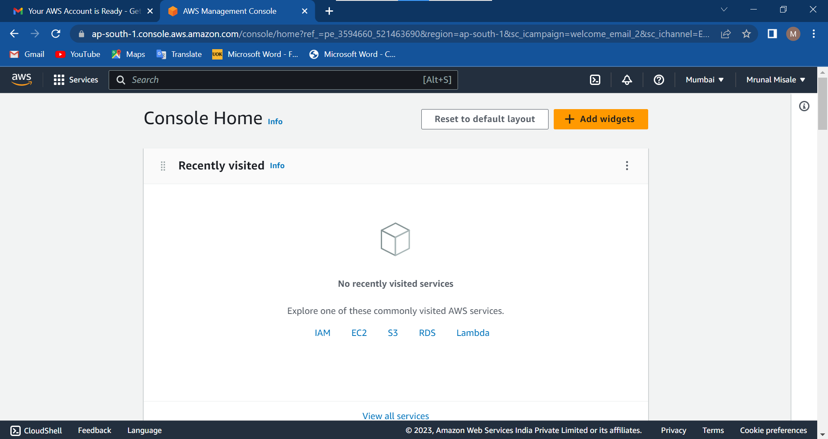
Implementation :

Slide 8
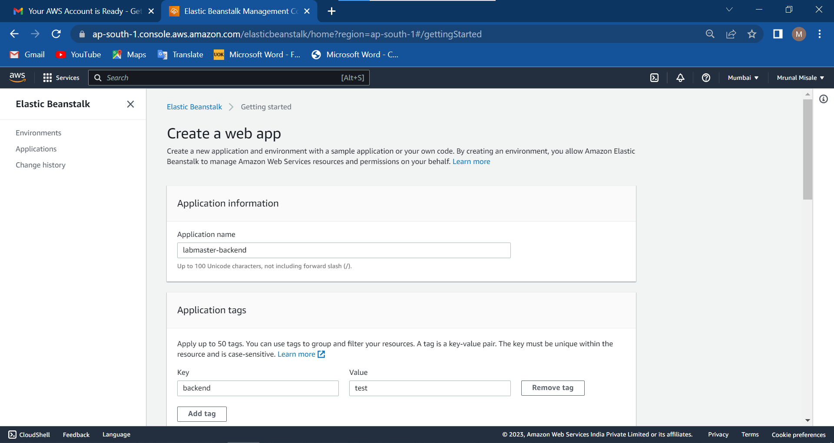

Slide 9
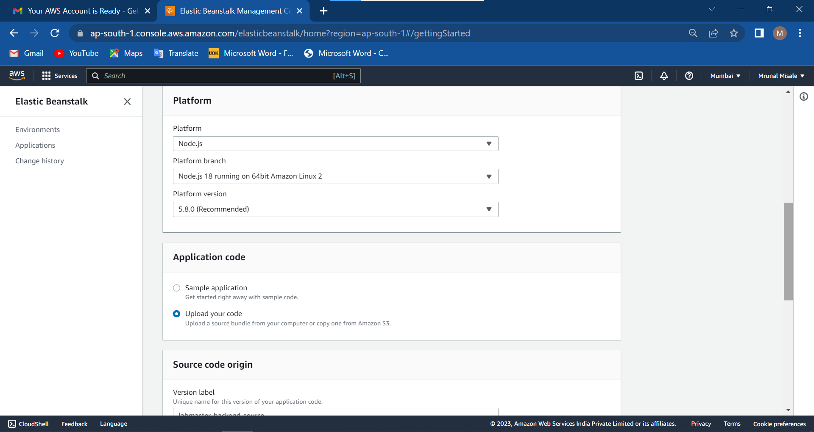

Slide 10
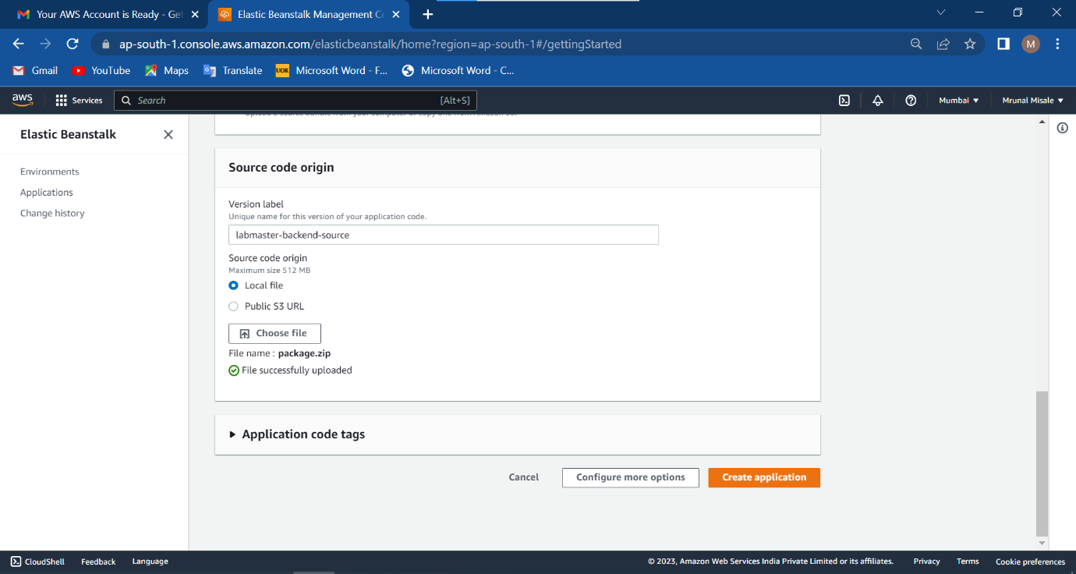

Slide 11
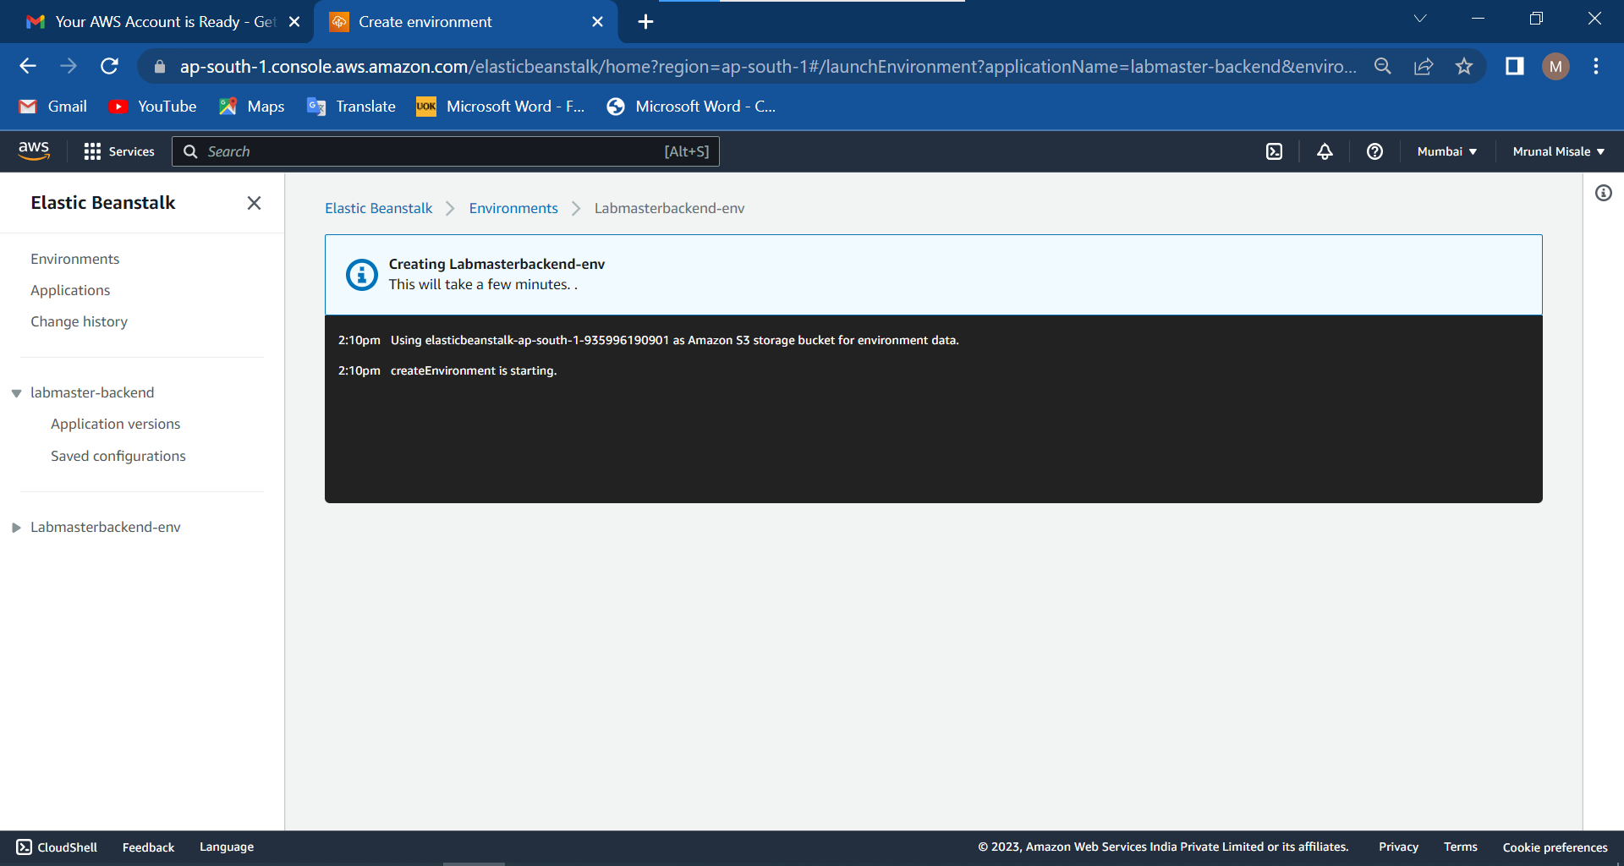

Slide 12
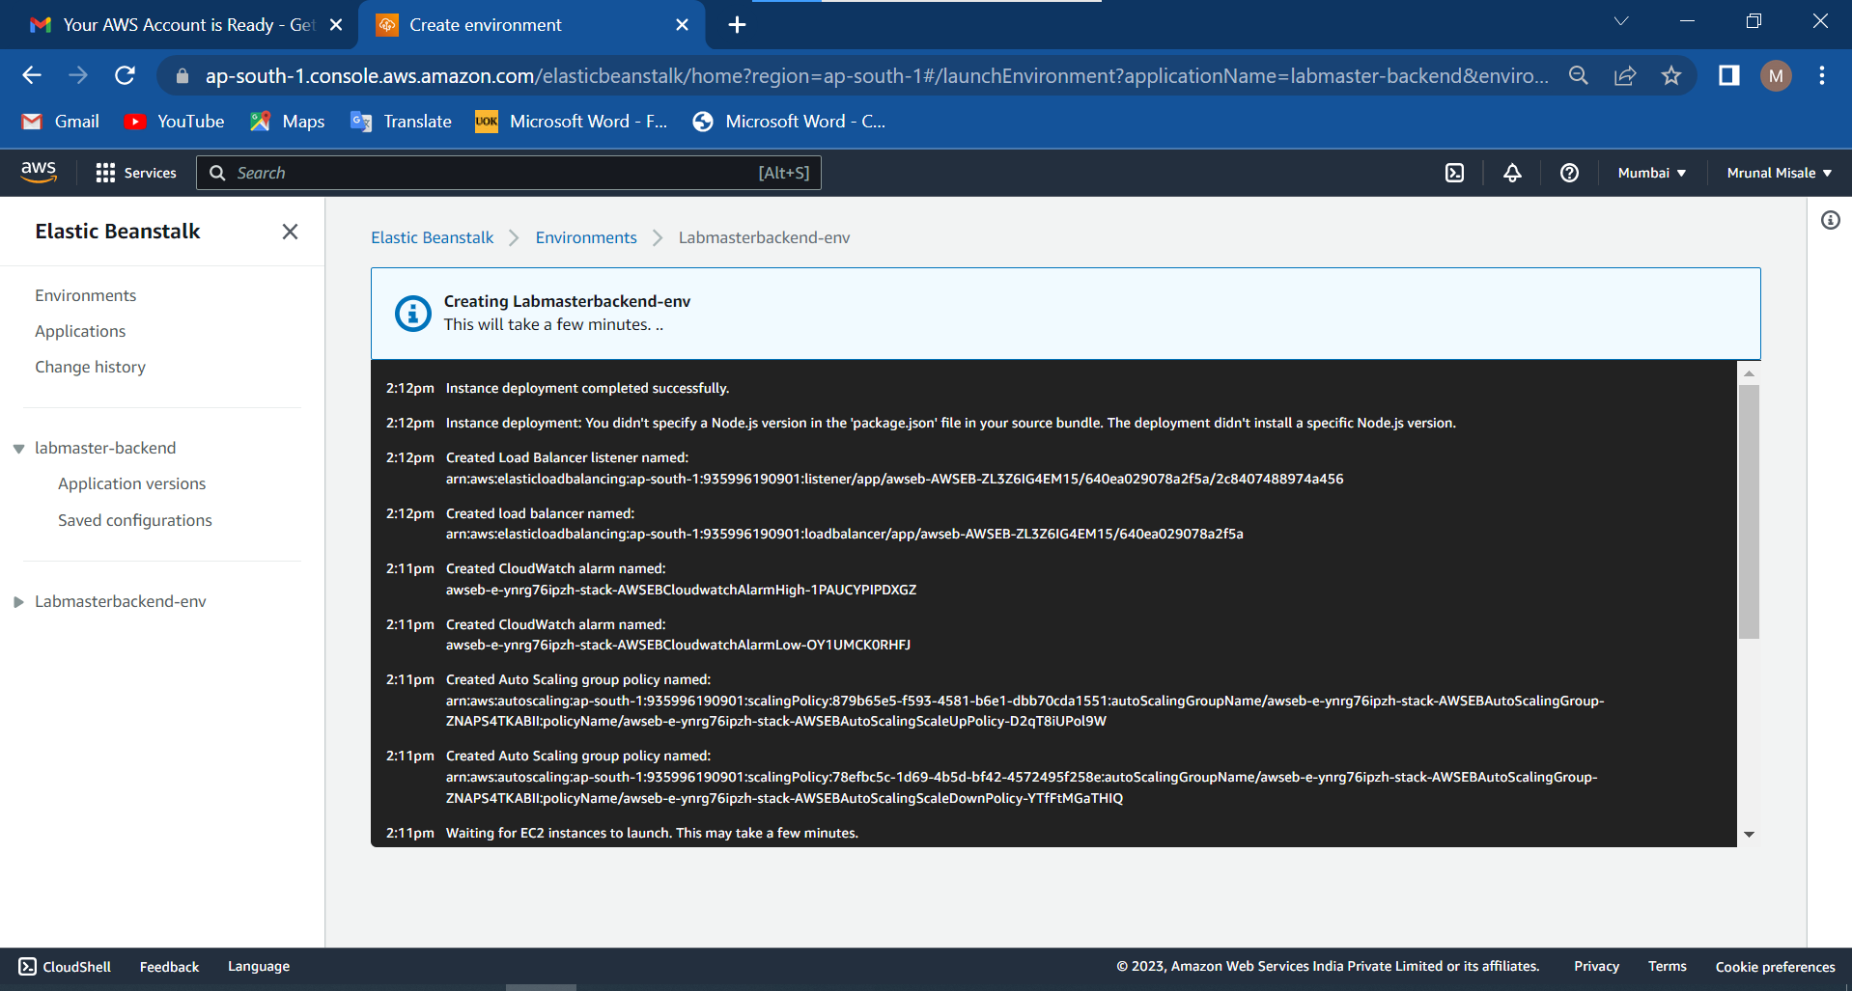

Slide 13
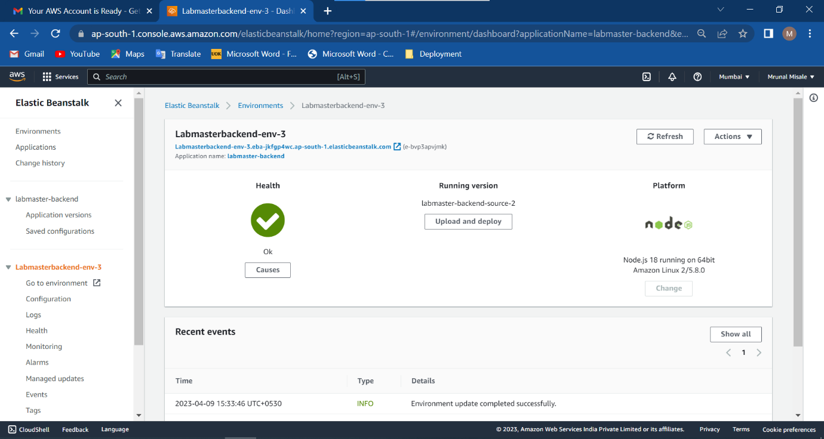

Slide 14
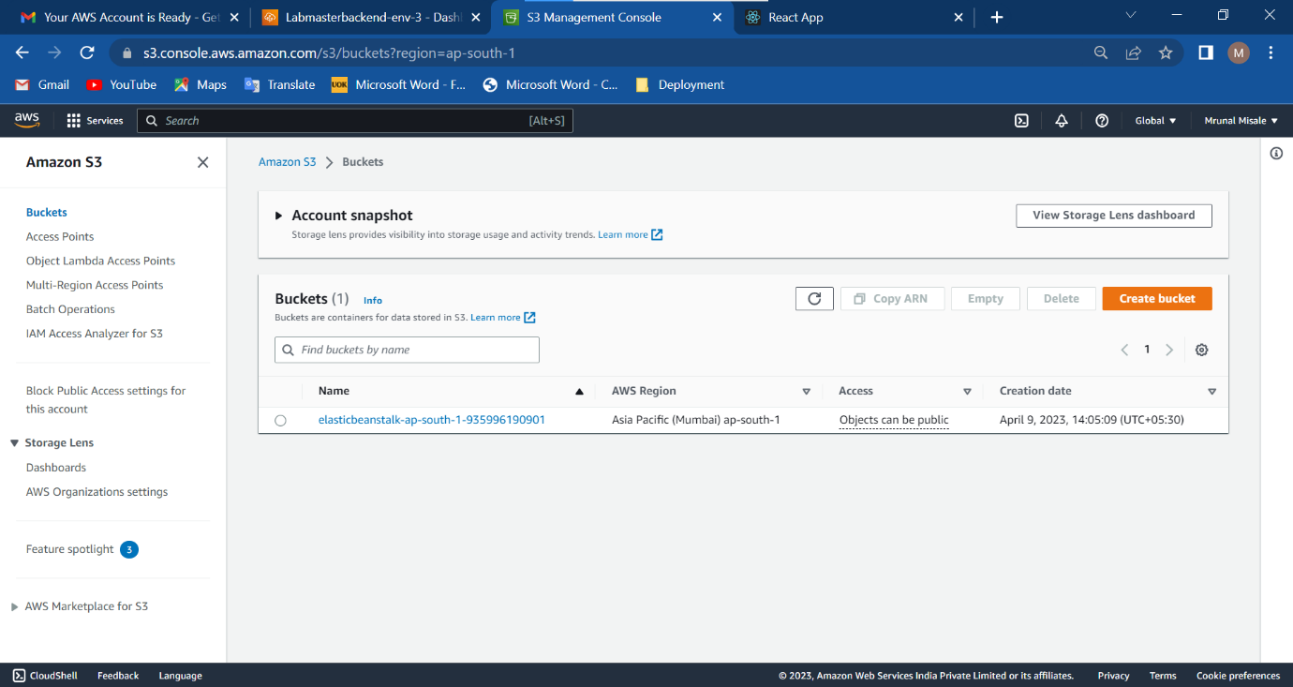

Slide 15
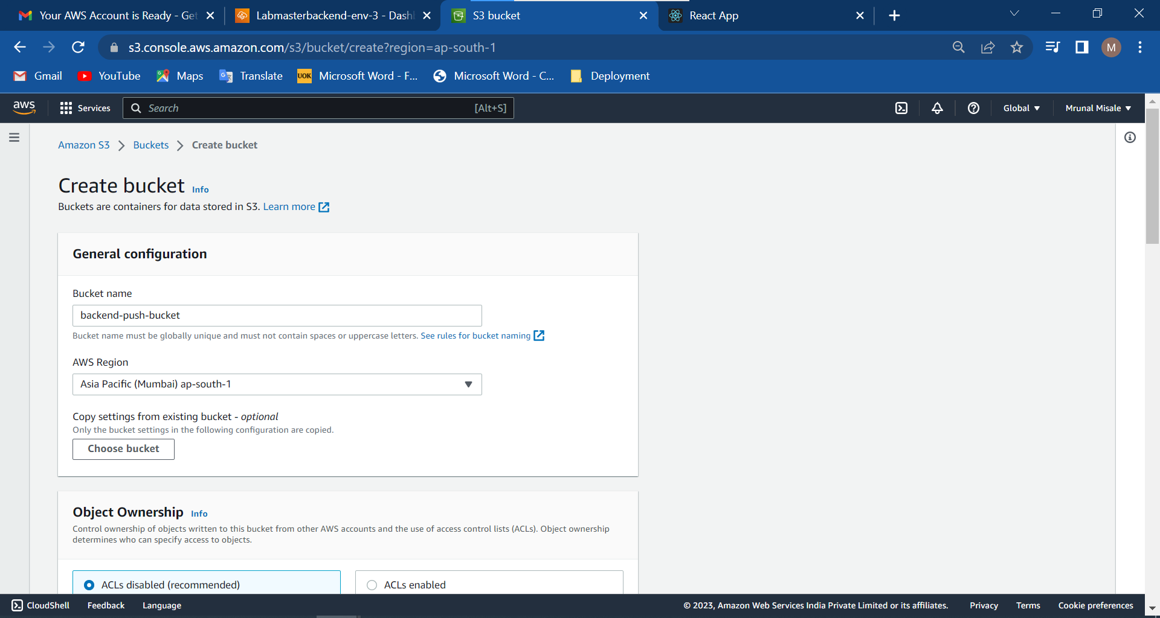

Slide 16
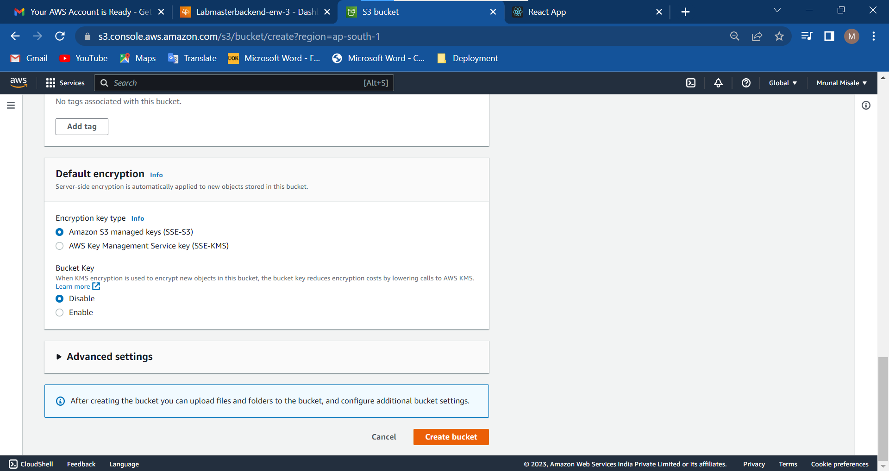

Slide 17
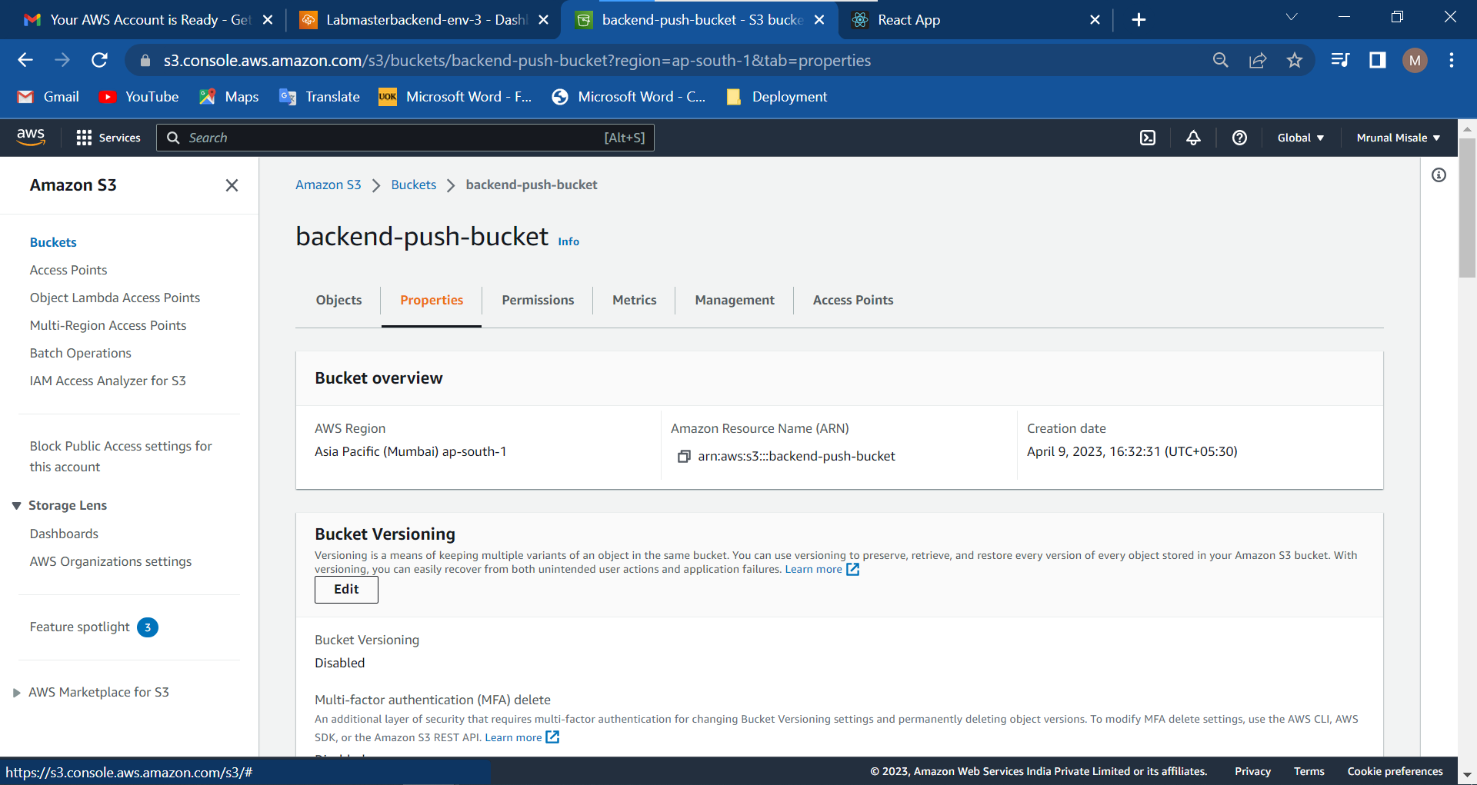

Slide 18
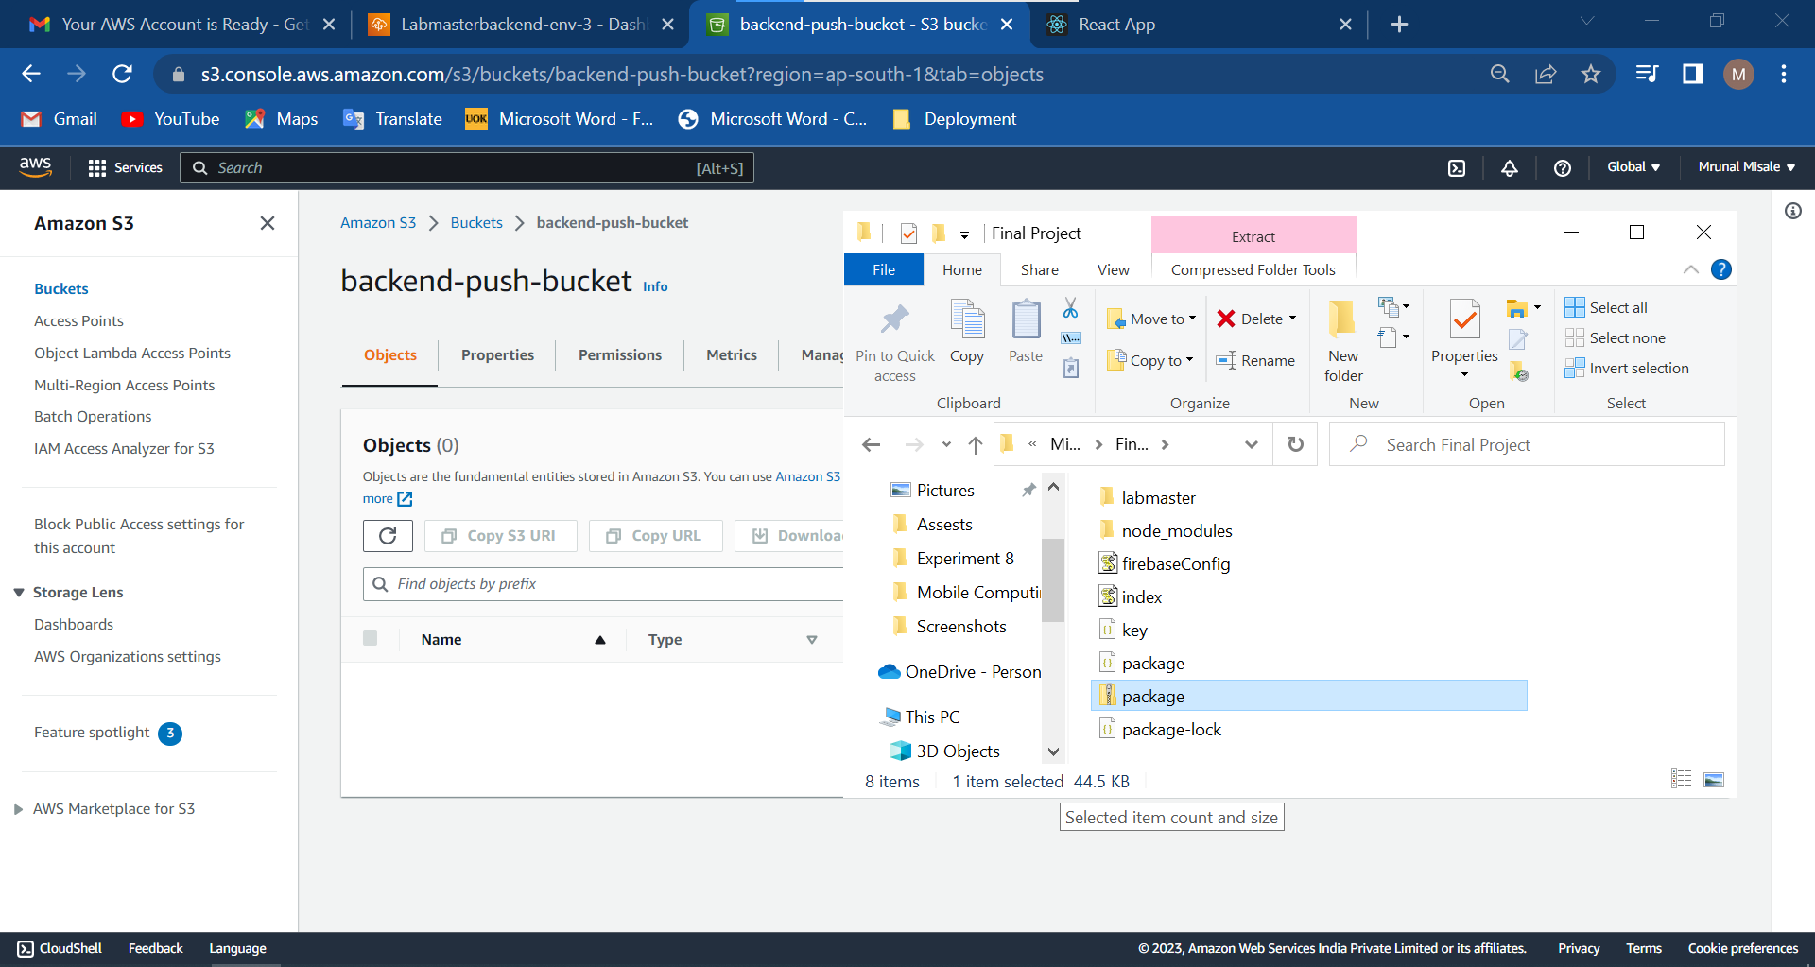

Slide 19
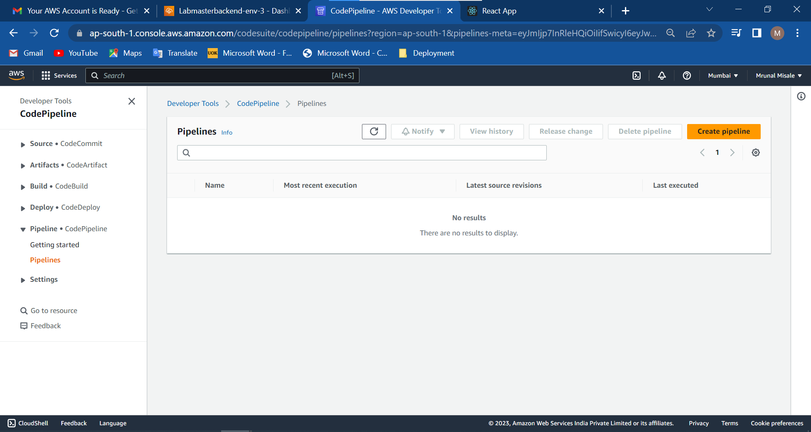

Slide 20
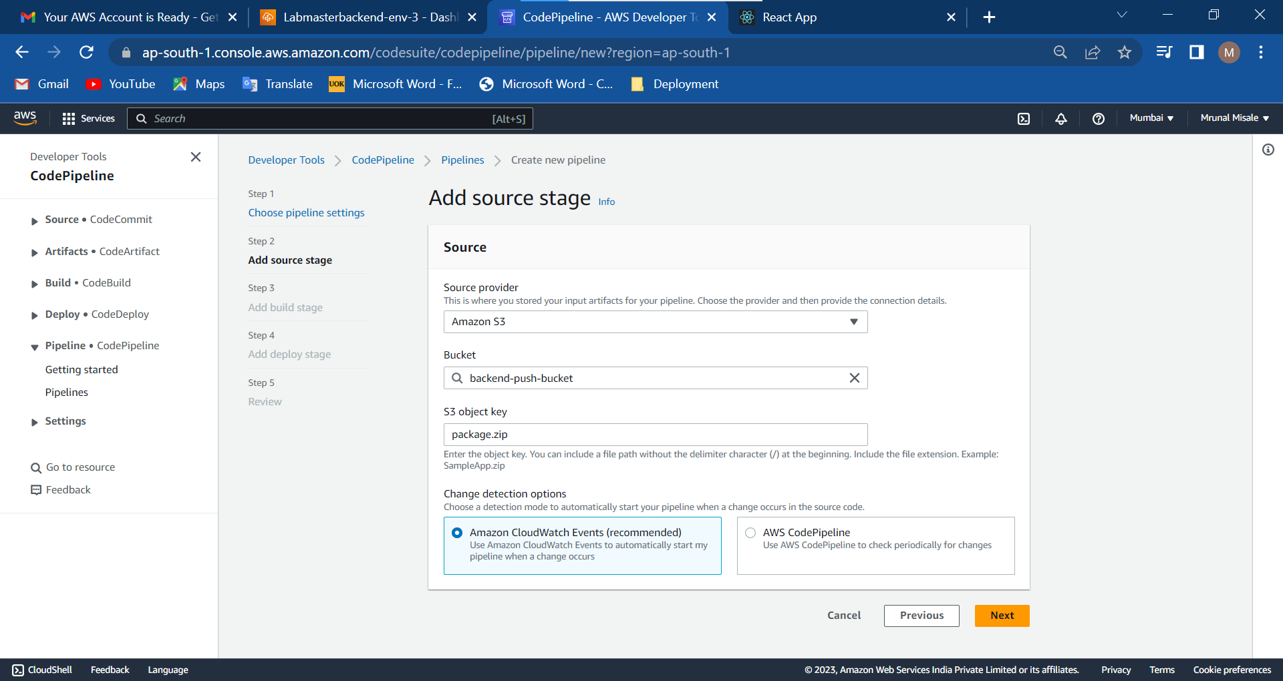

Slide 21
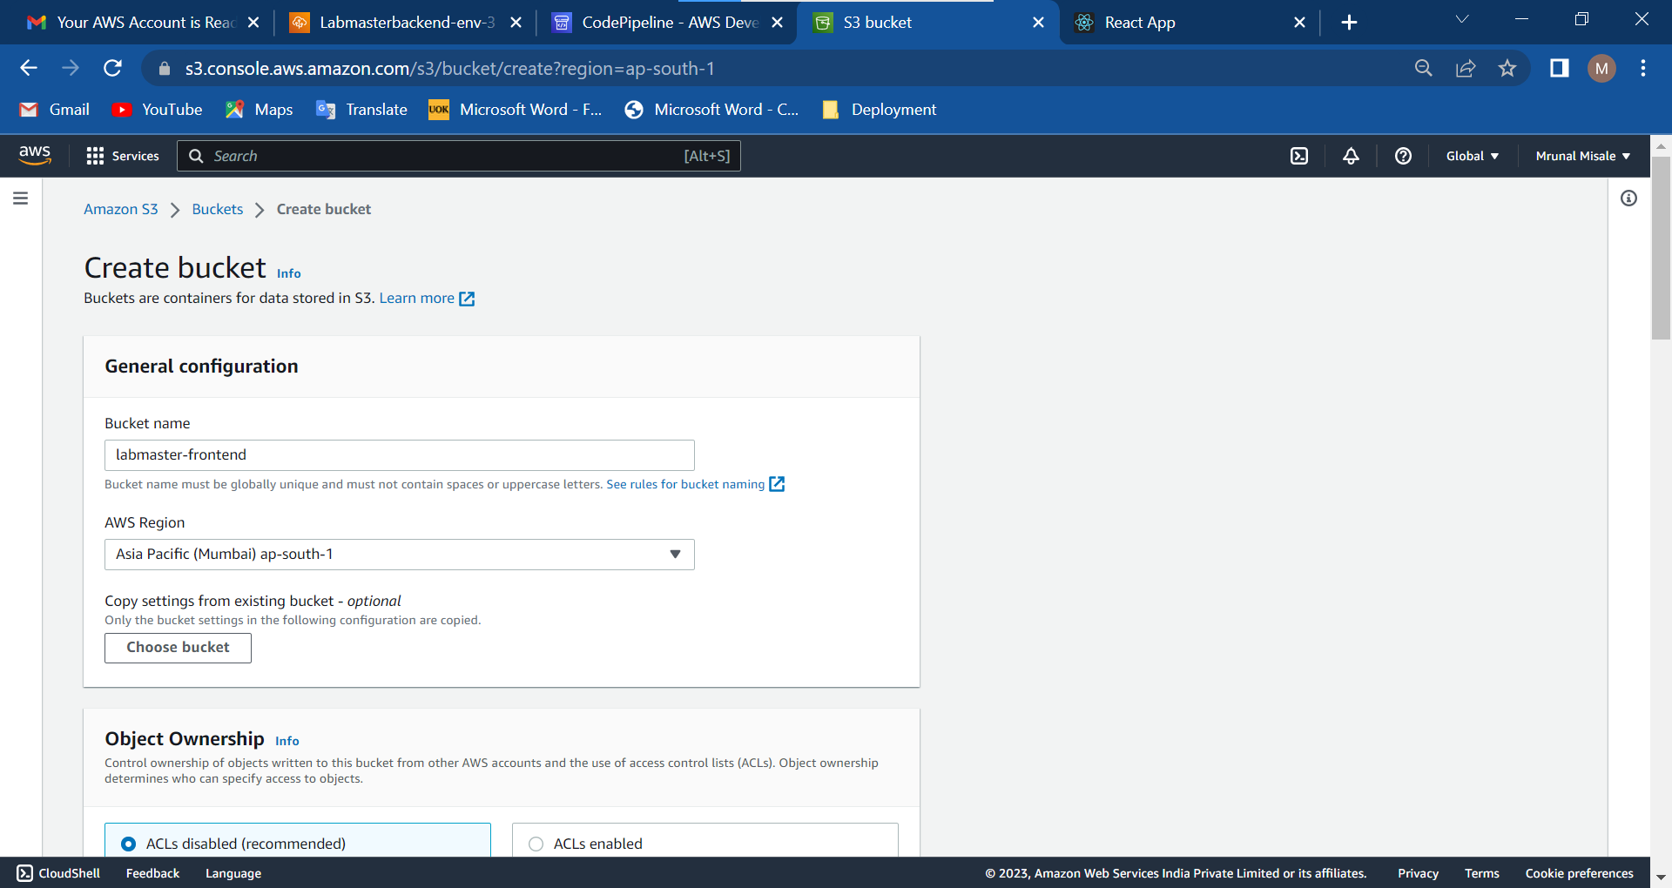

Slide 22
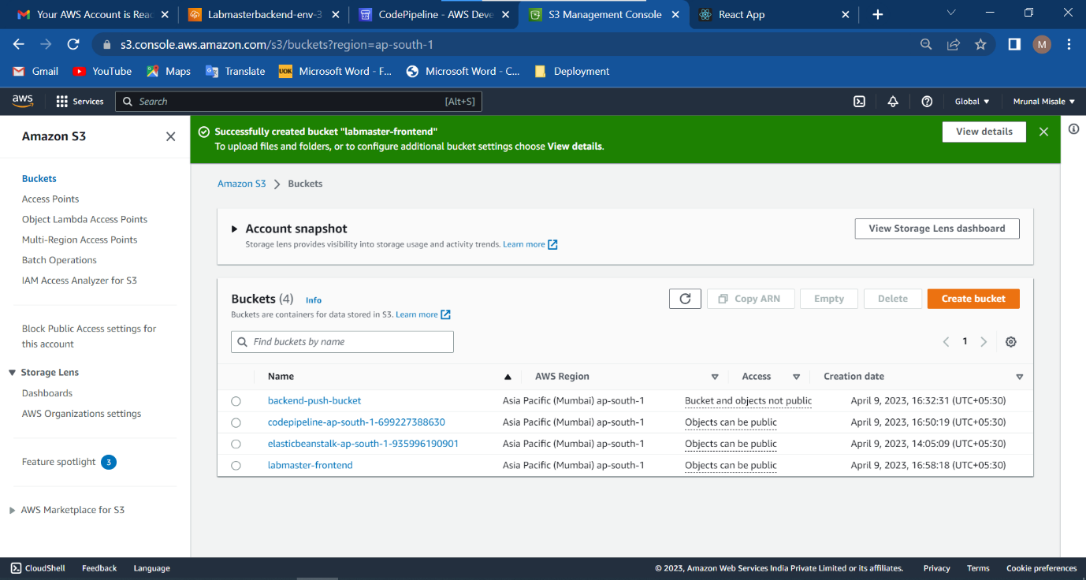

Slide 23
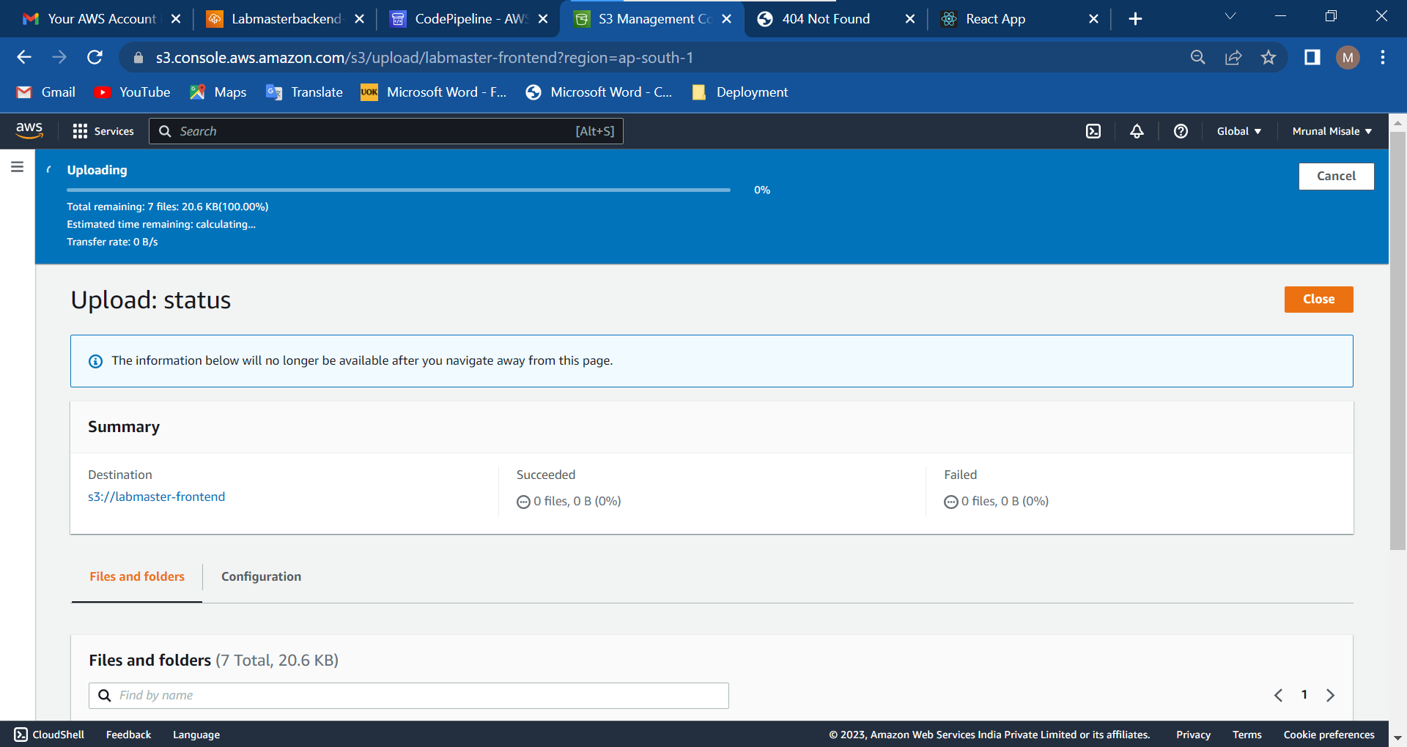

Slide 24
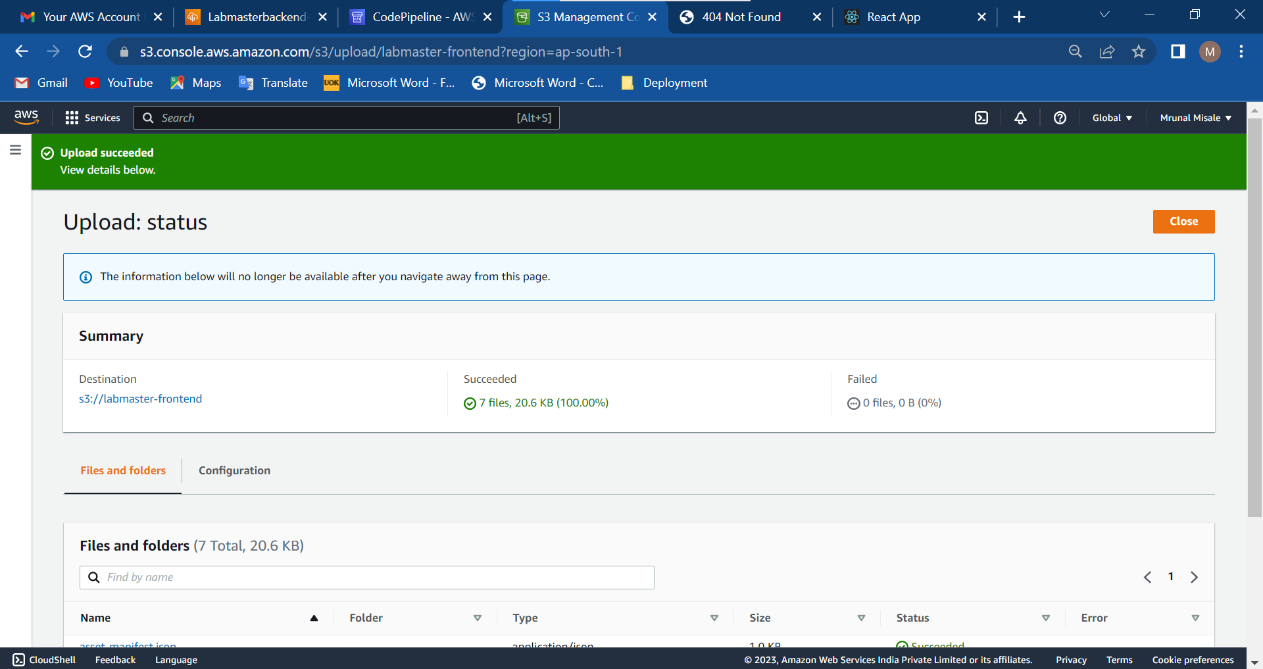

Slide 25
Demonstration :
Video as been Uploaded on https://drive.google.com/file/d/1jyQCGUk9_tkLiiCiPhPXyjO5GqYPU6jz/view?usp=share_link

